Slide 1
Weather Radar

Slide 2
How it works
Reflectivity
what it is
what you can see
Velocity
what it is
what you can see
Others
what you can see

Slide 3
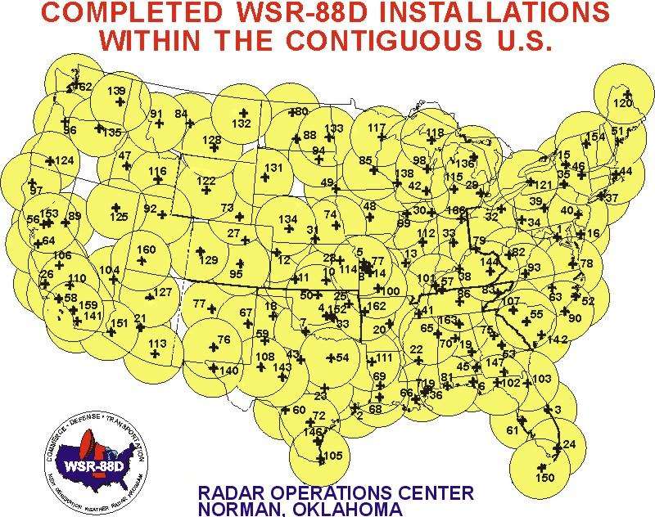
How it works
S-Band radar (10 cm wavelength)
158 in the US

Slide 4
Reflectivity (Base)
Lowest scan level
Closest to ground, but farther away from the radar not as close
Not always guaranteed to be raining if it’s on radar

Slide 5
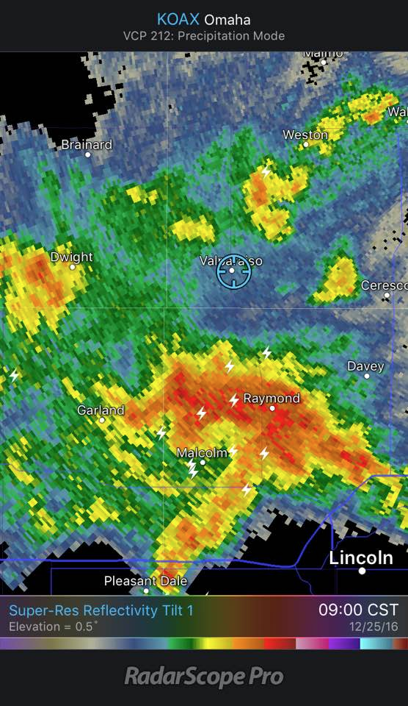
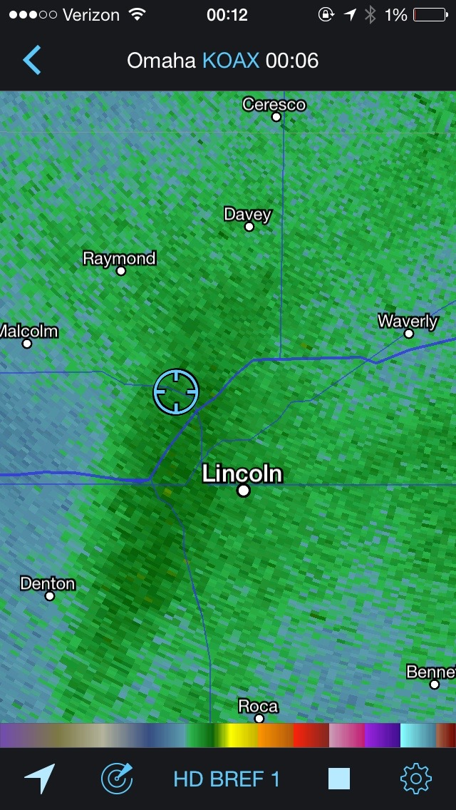
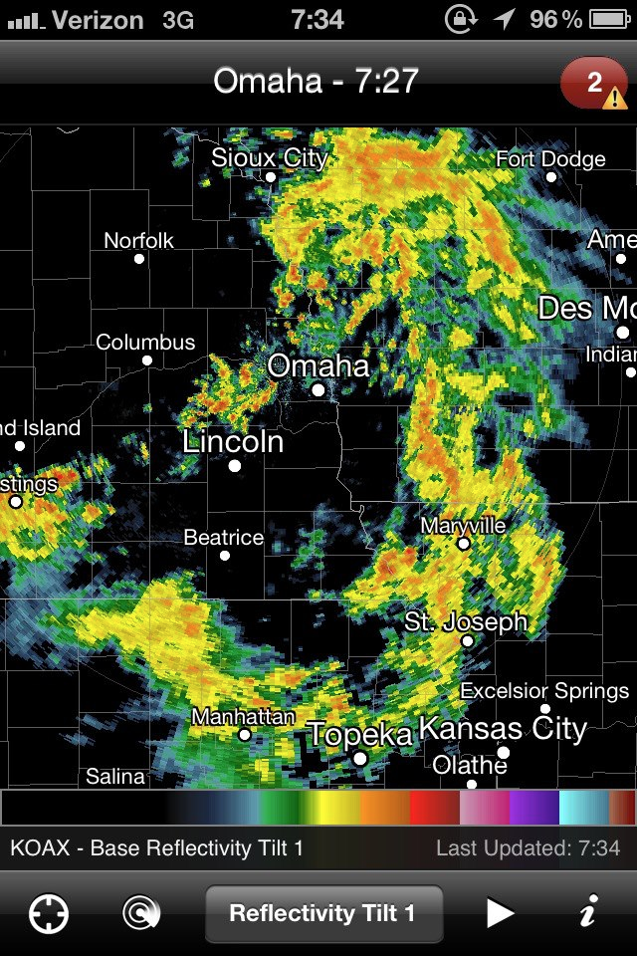
Rain/Snow/Sleet

Slide 6
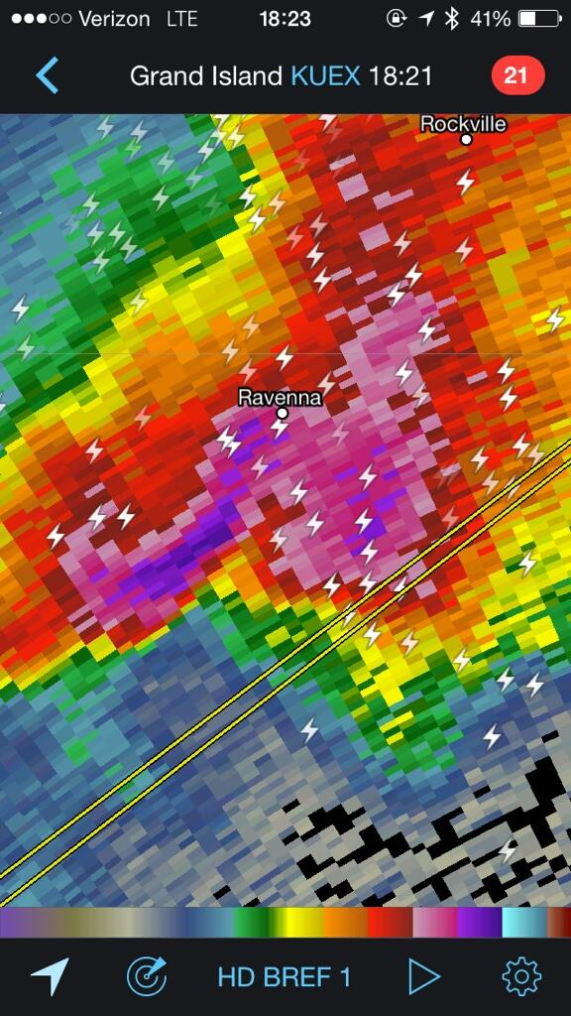
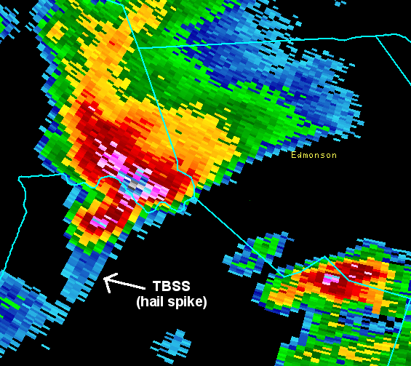
Hail? (Kinda)

Slide 7
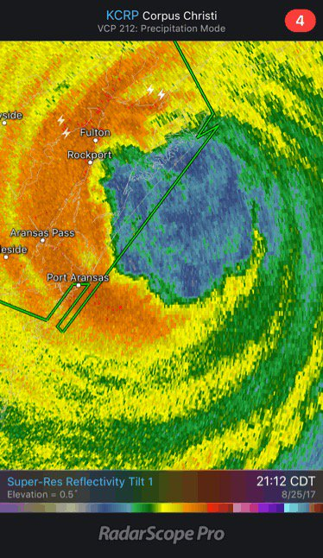
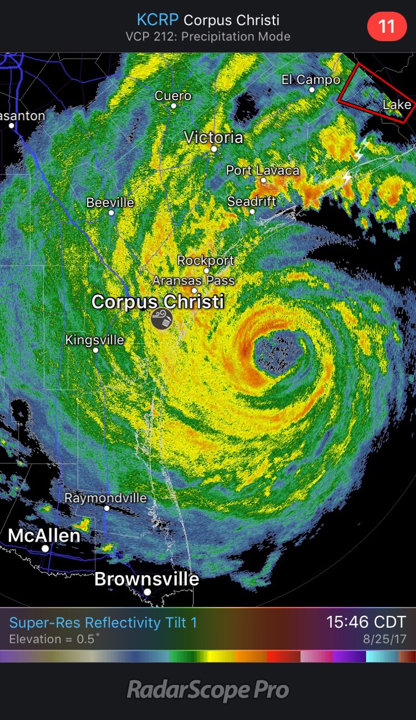
Hurricanes

Slide 8
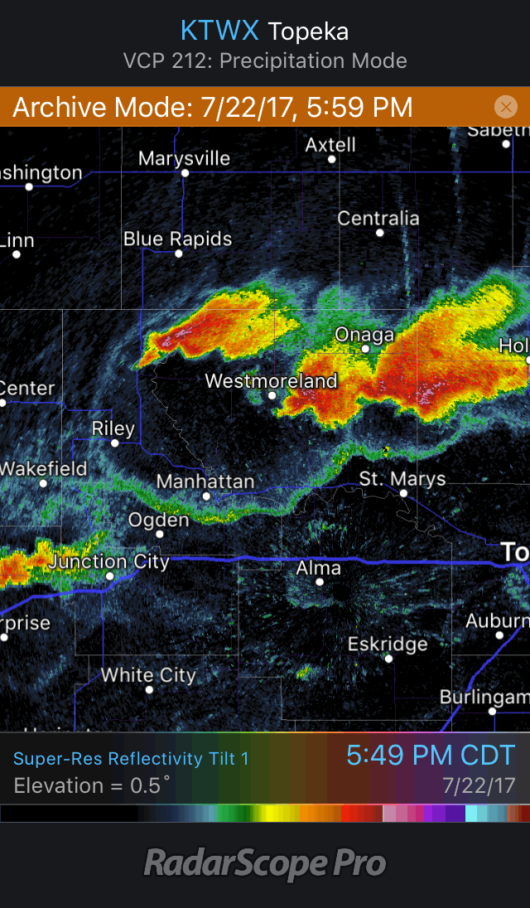
Outflow Boundaries
https://blog.wdtinc.com/hs-fs/hubfs/blog-files/RS_outflow.gif?t=1504149812495&width=640&name=RS_outflow.gif

Slide 9
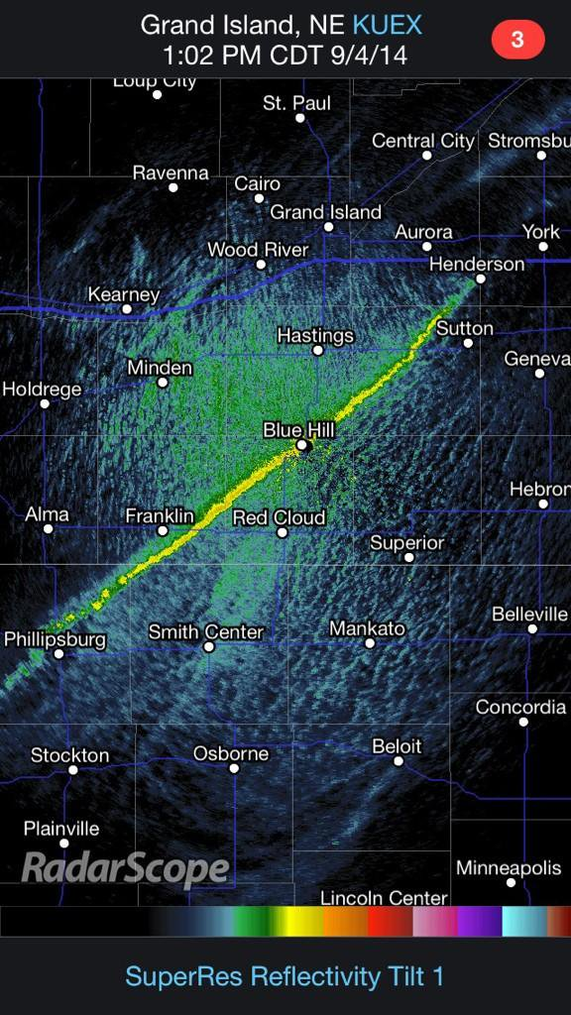
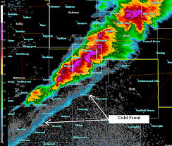
Fronts

Slide 10
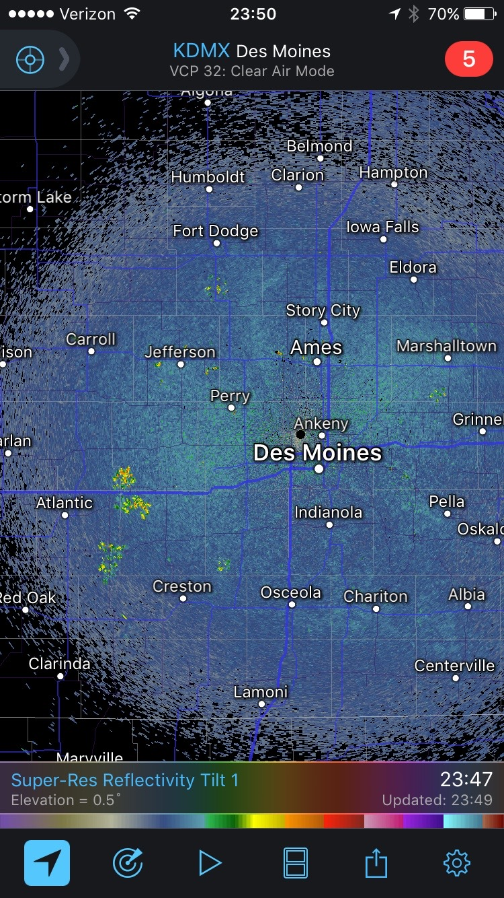
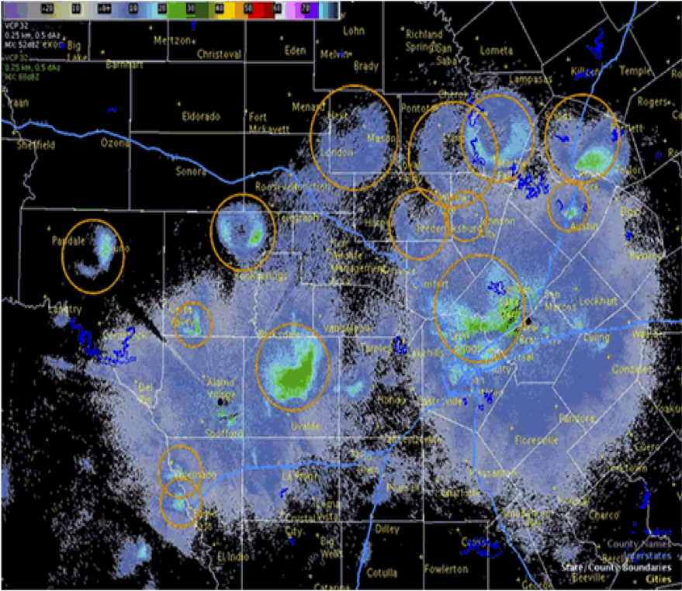
A little bit of everything
https://weather.com/science/news/radar-birds-bugs-bats-smoke-20130506

Slide 11
Velocity
Green = Towards
Red = Away
Only measures wind along the beam!

Slide 12
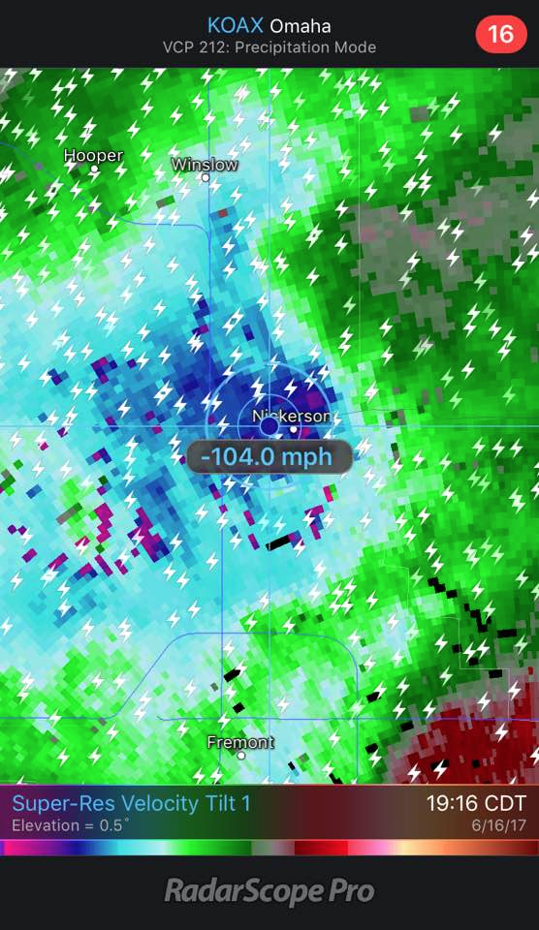
Severe Winds
https://blog.wdtinc.com/hs-fs/hubfs/blog-files/RS_straightline.gif?t=1504149812495&width=640&name=RS_straightline.gif

Slide 13
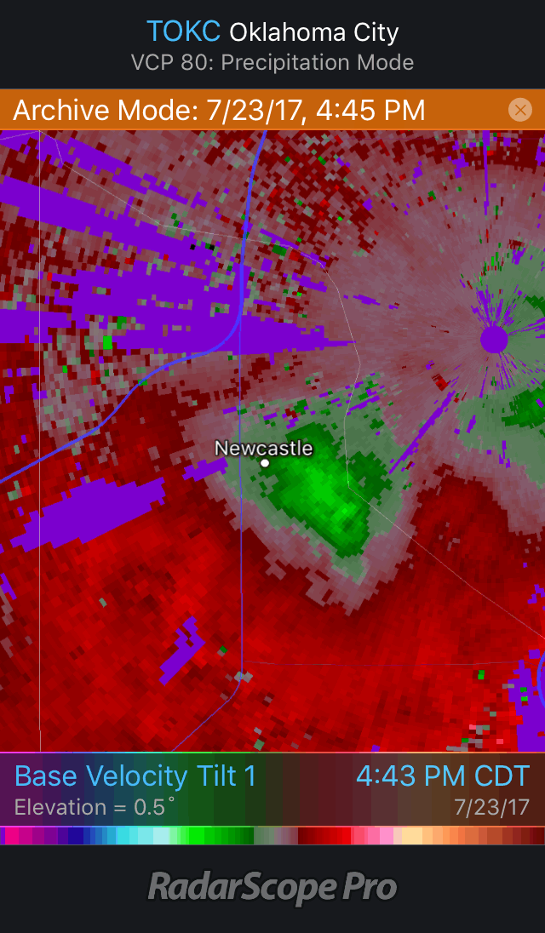
Downbursts
https://blog.wdtinc.com/hs-fs/hubfs/blog-files/RS_microburst_full.gif?t=1504149812495&width=640&name=RS_microburst_full.gif

Slide 14
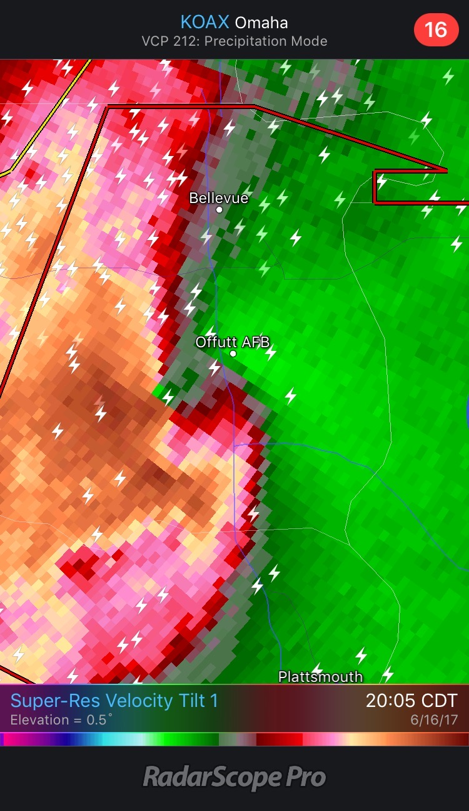
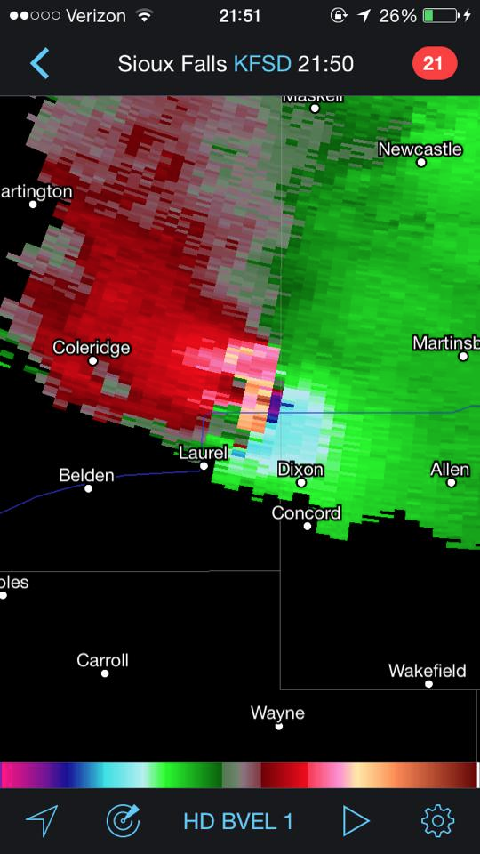
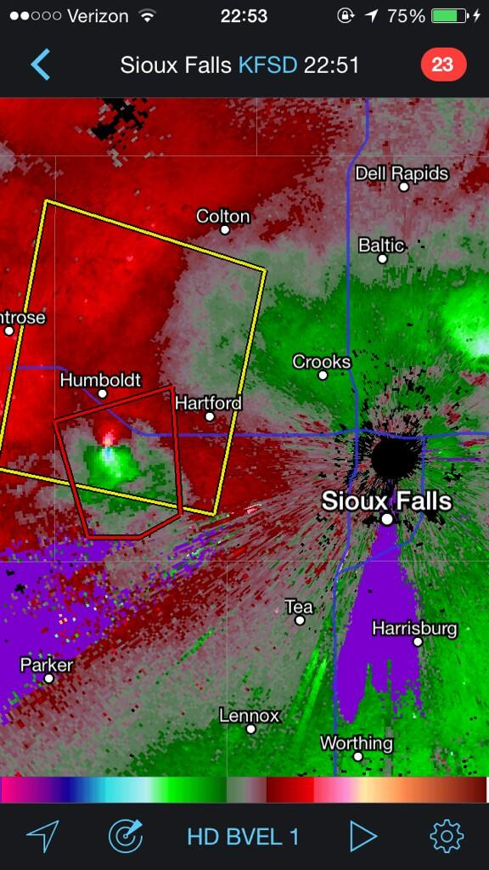
Tornadoes (Kinda!)

Slide 15
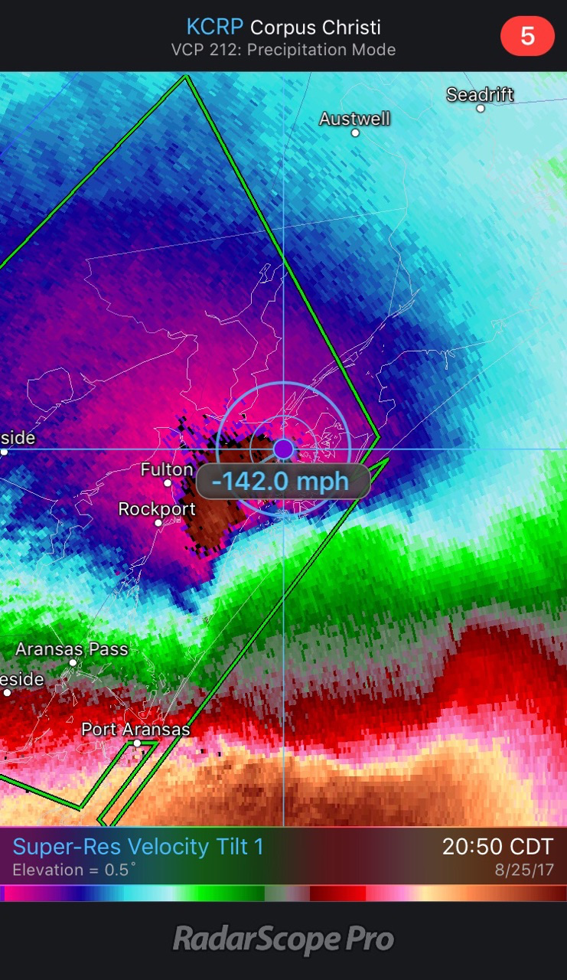
Hurricanes

Slide 16
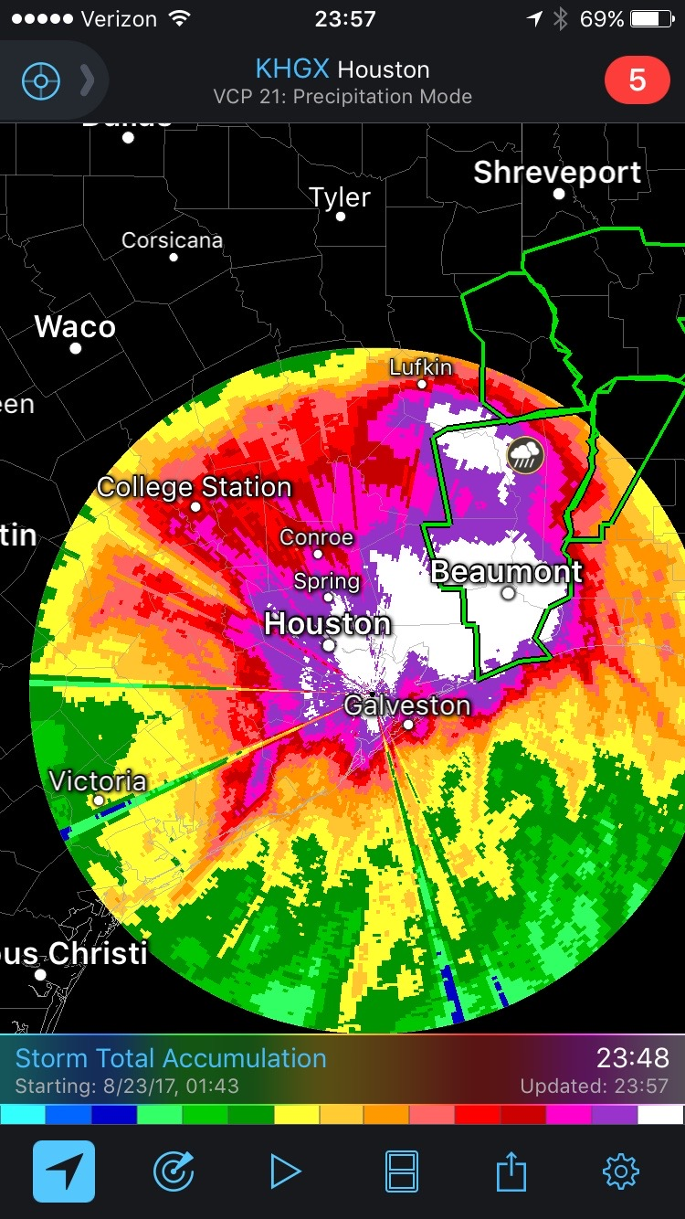
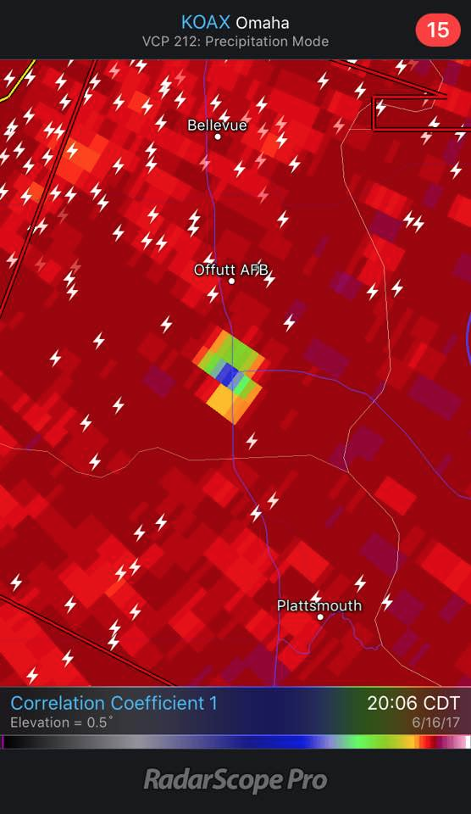
Other products

